Slide 1
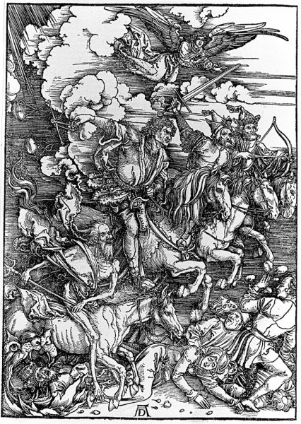
The Research Skills exam:
The four horsemen of the apocalypse: pestilence, war, famine and the RS1 exam.

Slide 2
The exam format:
Two hours and five sections –
Section 1: basic concepts
Section 2: interpreting SPSS output
Section 3: which test?
Section 4: pick a test and conclusions
Section 5: write a results section

Slide 3
Be strategic:
Don’t start at page 1 and work through. Each section carries equal marks.
Answer all the easy questions first! Then tackle tricky stuff if there is time left.
Notes:
This is very important!

Slide 4
Section 5: Write a results section
Read the scenario supplied; write a results section; interpret the results appropriately.

Slide 6
“A Mann-Whitney test revealed that combining visualisation techniques and football training did not improve footballers' performance more than football training alone, U (8, 8) = 21.00, p > .05. Footballers in the visualisation plus training condition scored a mean of 12.00 goals in a season (SD = 4.93), whereas footballers in the training-only condition scored only 9.12 goals (SD = 3.76).”

Slide 8
“There was a strong positive correlation between participants' best scores on a racing game and their average lap time at a race-track, r(6) = .87, p = .005. The higher a participant's racing game score, the longer their lap time. These results run contrary to the original hypothesis. Although the ability to perform well on a computer driving game is a good measure of a person's ability to drive on a real driving track, it is in the opposite direction to what was predicted originally: people who perform well on the game actually perform worse (drive more slowly) on the race track.”

